Slide 1
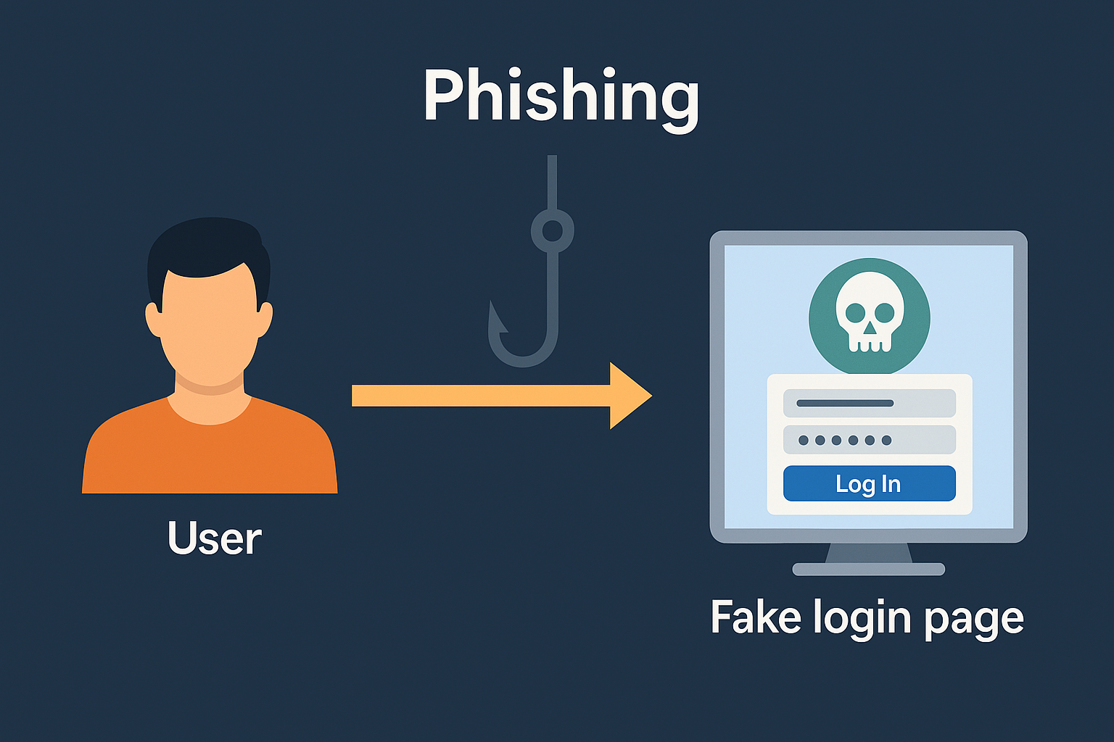
Phishing Attack Simulation on IoT Dashboard Website

Slide 2
Phishing Attack Simulation (Educational Demo)
Objective: Demonstrate a phishing attack in a controlled environment.
Context: IoT dashboard login page.
Tools: XAMPP, PHP, HTML, and browser.

Slide 3
Phishing Basics
Phishing is a form of social engineering.
Attackers trick users into giving credentials.
Common in emails, fake sites, and messages.

Slide 4
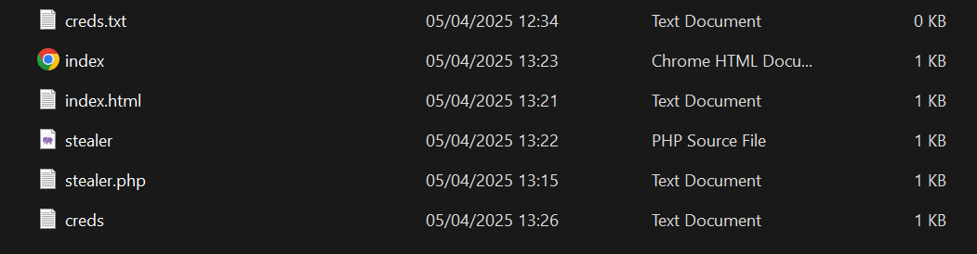
Simulation Environment
Local server: XAMPP Apache on Windows
Project folder: C:/xampp/htdocs/phishing-demo
Files:
- index.html: Fake login form
- stealer.php: Credential logger
- creds.txt: Logs the credentials

Slide 5
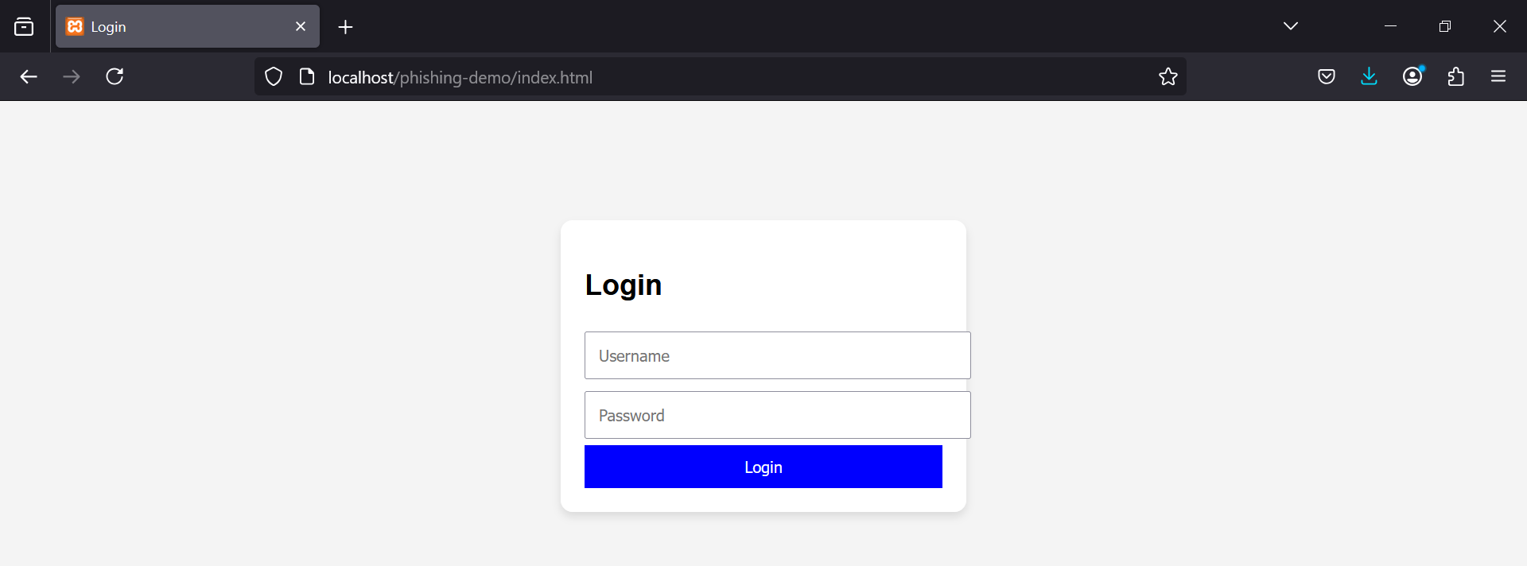
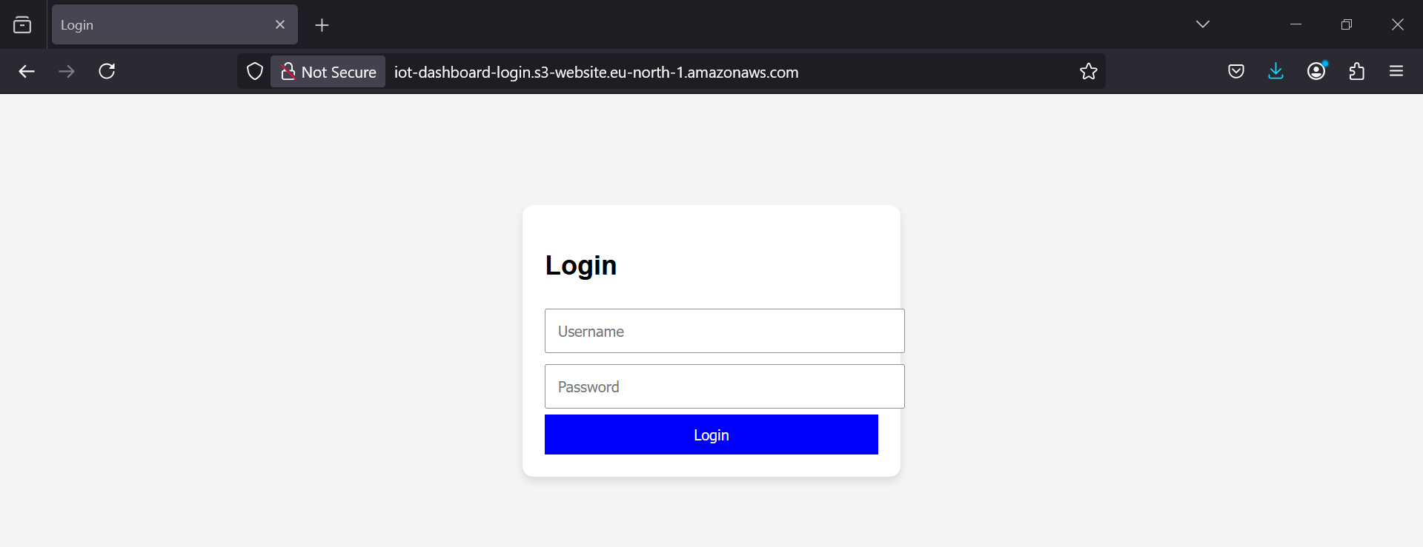
Step 1 - Fake Page Interface
User visits http://localhost/phishing-demo/index.html
Sees a login form mimicking a real IoT dashboard
No visual clues indicating malicious intent.

Slide 6
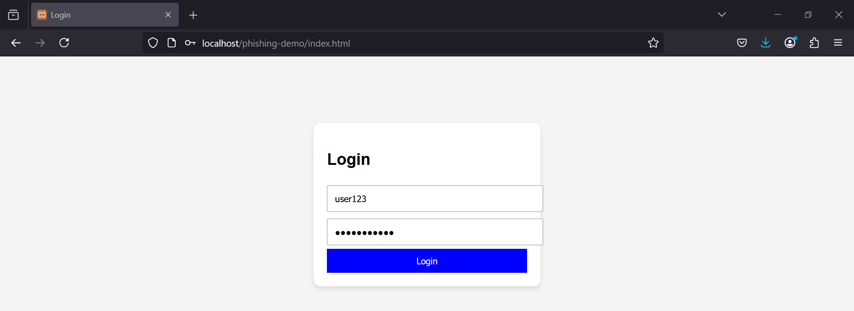
Step 2 - Simulated User Login
User enters user123 / password123
Submits the form
Form action sends data to stealer.php

Slide 7
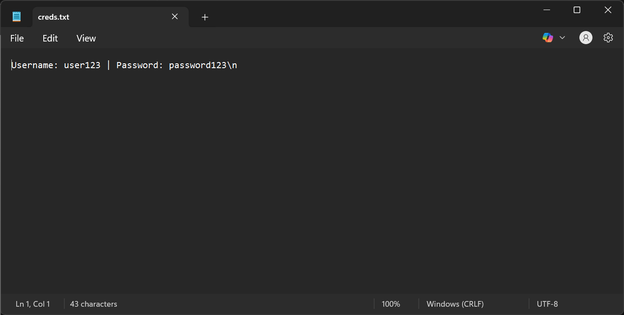
Step 3 - Logging Credentials and Access
stealer.php logs the POST data into creds.txt
Stealthily redirects the user to the real IoT dashboard
User likely unaware of the interception
Open creds.txt
Logged output: Username: user123 | Password: password123
Demonstrates successful phishing capture

Slide 8
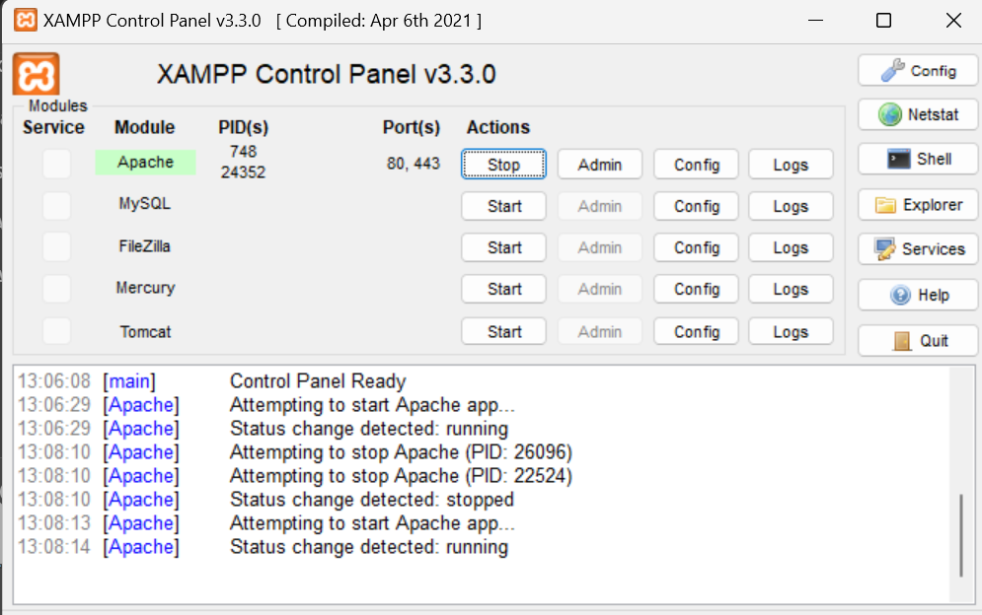
XAMPP Control & File Setup
Apache is running and serving files
Proper folder structure in htdocs
Multiple test files confirm setup success

Slide 9
How to Prevent Phishing
Enforce Multi-Factor Authentication (MFA)
Use HTTPS with HSTS
Educate users on URL awareness
Employ email filters and browser warnings

Slide 10
Key Takeaways
Phishing remains a top cyber threat
Simulations help understand vulnerabilities
Prevention through layered security and awareness

Slide 11
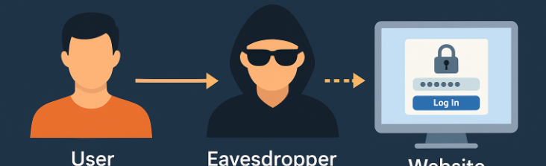
MITM Attack Overview
MITM (Man-in-the-Middle) attacks allow an attacker to intercept communication between a user and a service.
In this simulation, mitmproxy was used to intercept HTTP traffic to an IoT login page.

Slide 12
MITM - Request Interception
The attacker intercepts the GET request to load the page, along with any assets.
All traffic passing through mitmproxy can be logged, inspected, and even modified.

Slide 13
MITM - Capturing Credentials
When a user submits credentials over HTTP, the attacker captures the POST request in plain text.
Example:
username=user123&password=pass123
This data is fully visible to the attacker.

Slide 14
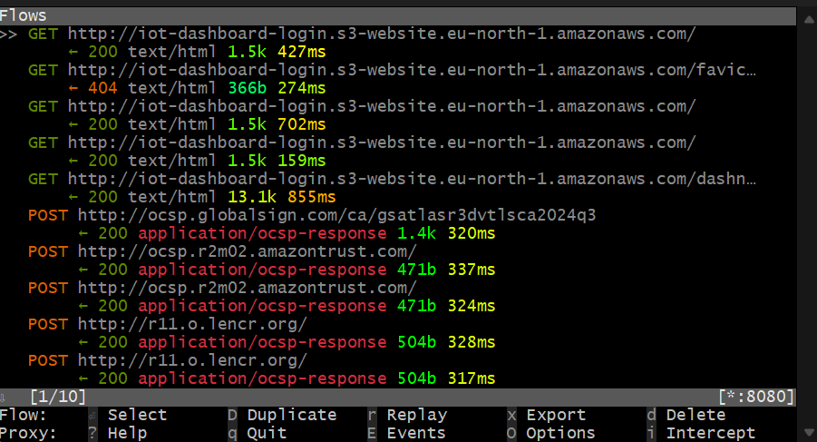
MITM - Demo Screenshot
This screenshot from mitmproxy shows intercepted GET and POST requests from the IoT login page.
It highlights the real-time visibility an attacker would have in an unsecured environment.

Slide 15
Defending Against MITM Attacks
✅ Enforce HTTPS (TLS) on all web pages
✅ Use HSTS to prevent HTTP fallback
✅ Implement certificate pinning
✅ Educate users on avoiding public/unsecured Wi-Fi
✅ Use VPNs and endpoint protection

